Slide 1
elementia
teen literary magazine
from johnson county library

Slide 2
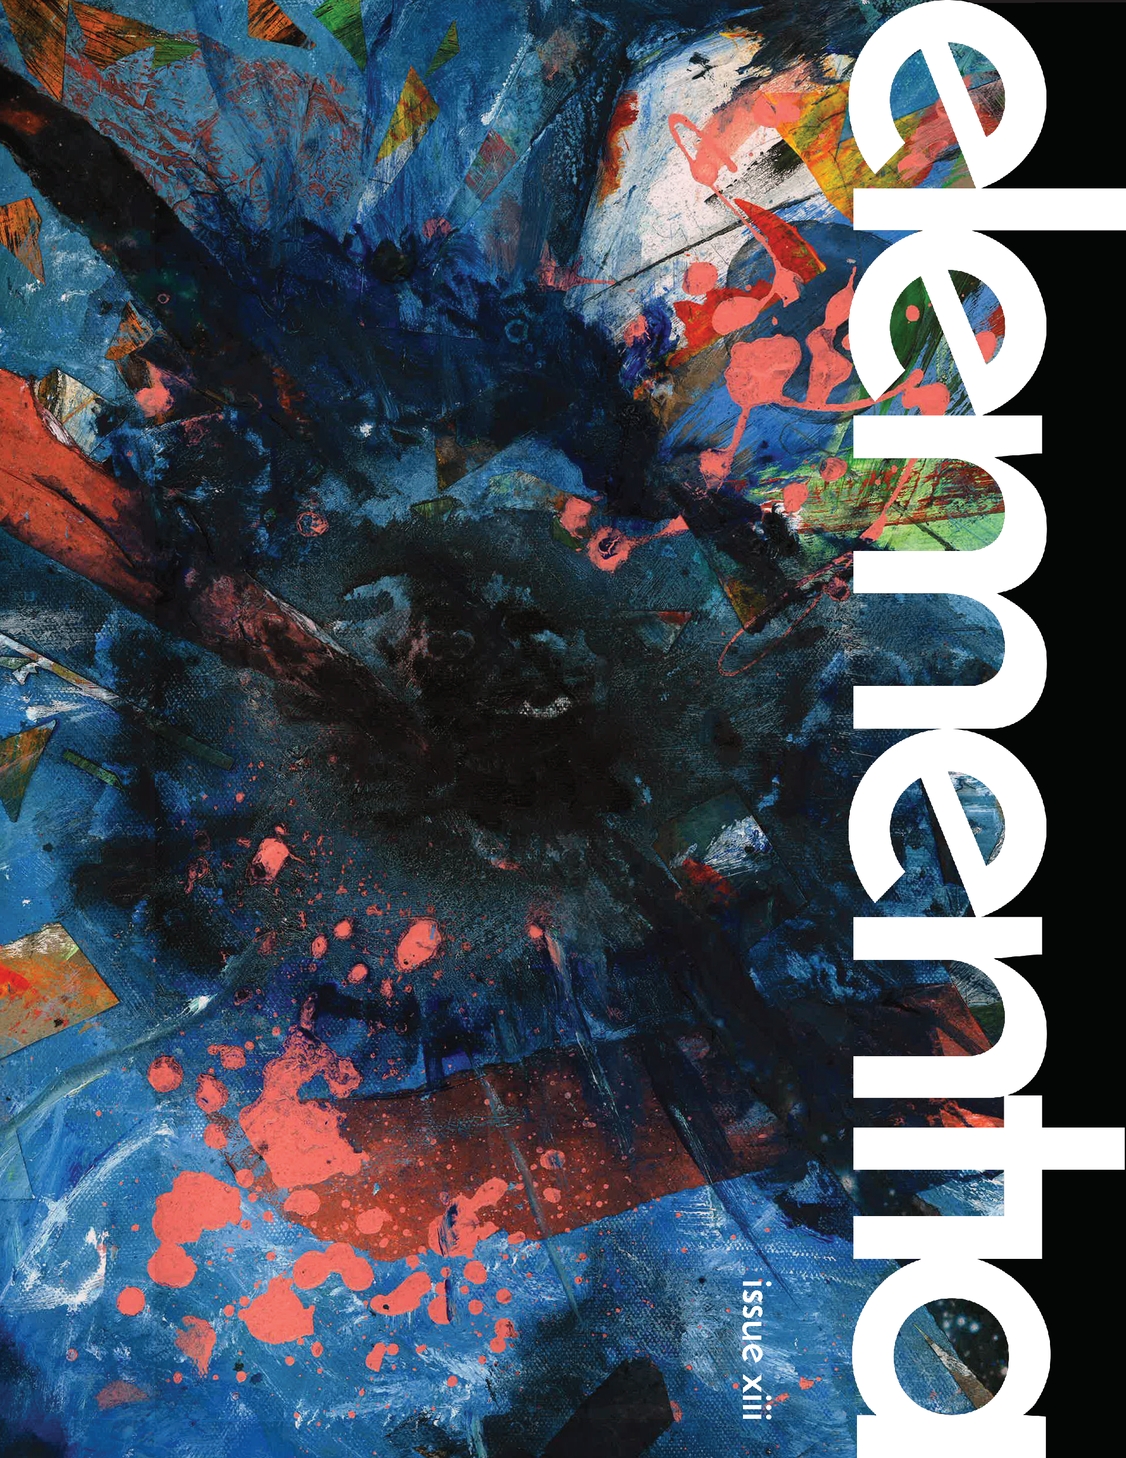
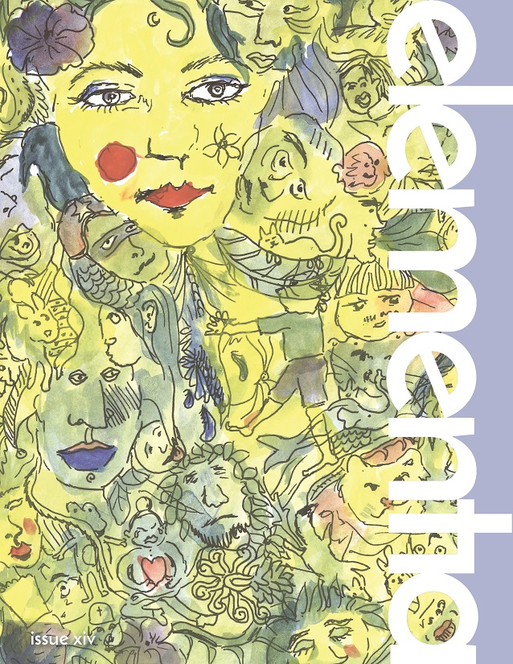
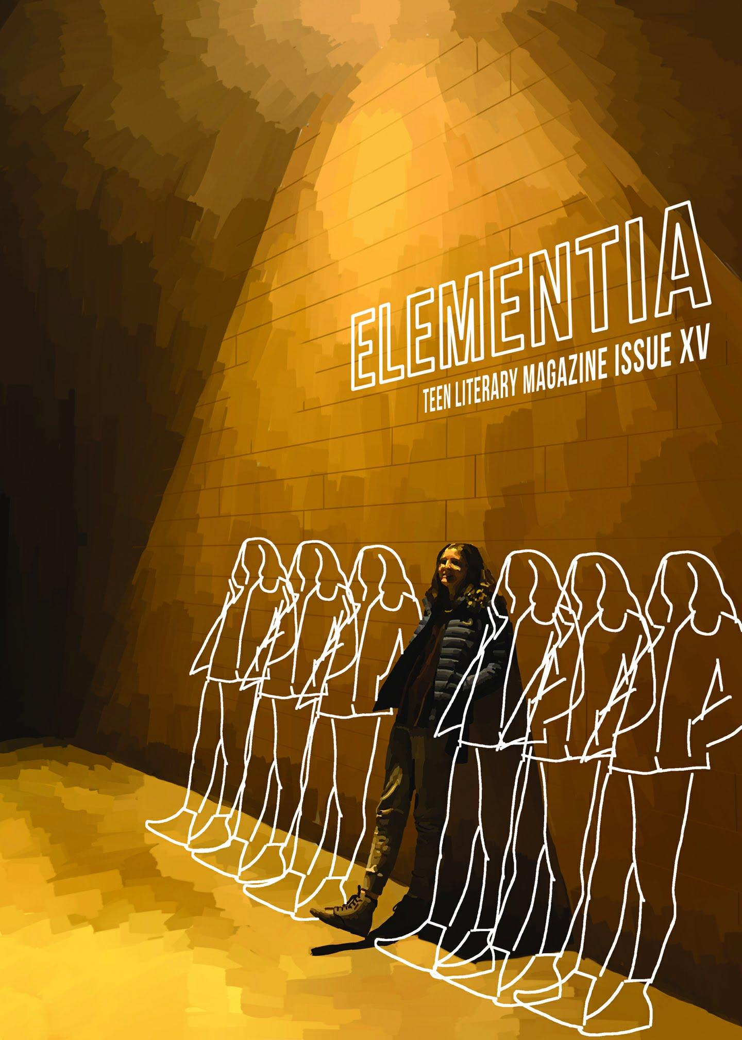
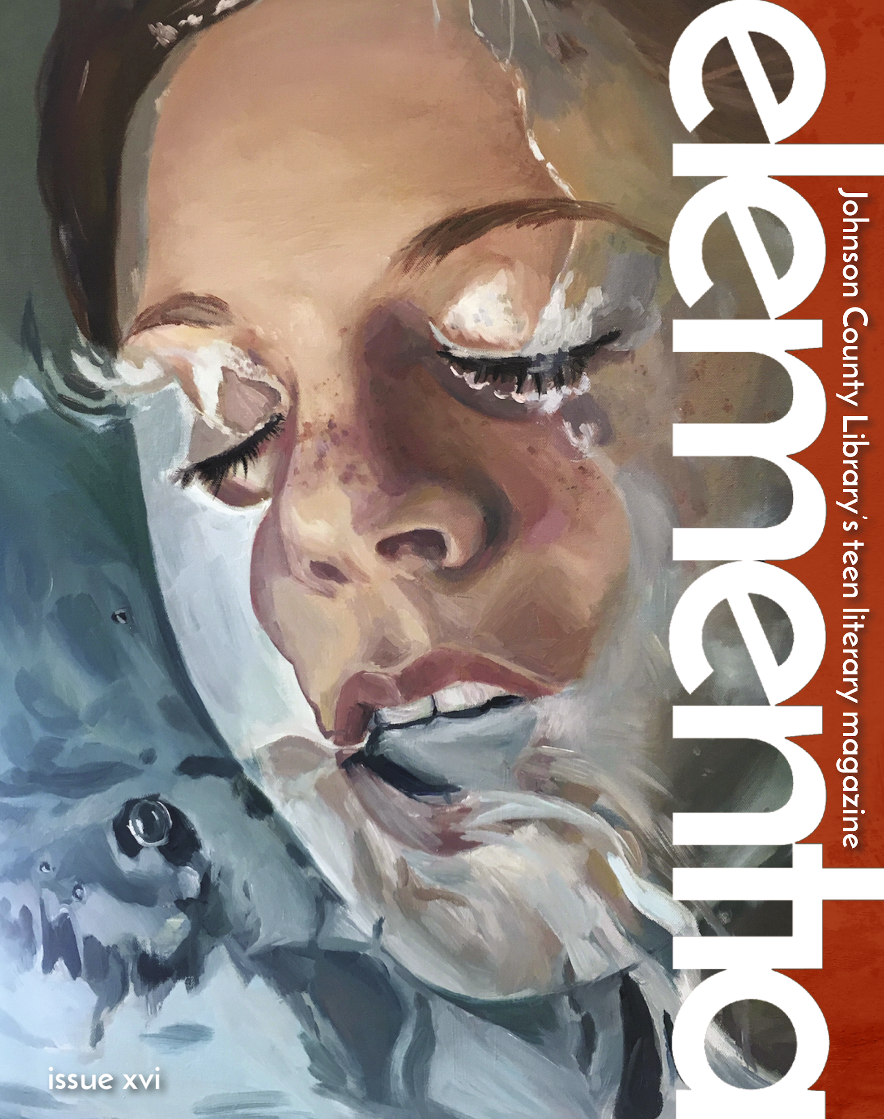
elementia
Published annually by Johnson County Library
Edited and designed by teens
Free!
Anyone 12-19 can submit work for consideration
Notes:
Mission Statement
The purpose of elementia is to publish, uplift and represent creative, eclectic teens, while also striving to:
foster and recognize the talent of teens.
maintain an open platform/forum for teens to share and connect.
publish a diverse range of original writing and art.
collaborate with community partners and schools to embed elementia into the classroom.
emphasize the importance of reading and the written word by connecting published artists with talented teens.
Facts
How many teens have been published in elementia?
elementia had published the writing and art of 730 creative teens since 2005 in 15 issues of the magazine.
Where have our authors been from?
elementia has published teens from all over the Kansas City Metro area, several states, England, Zambia and Malaysia.
Who produces elementia?
elementia is managed by Library staff, but the selection and design work is all done by a committed group of creative teens. They select the pieces that will go into the magazine, they design the magazine, and they choose the next theme and featured author.

Slide 3
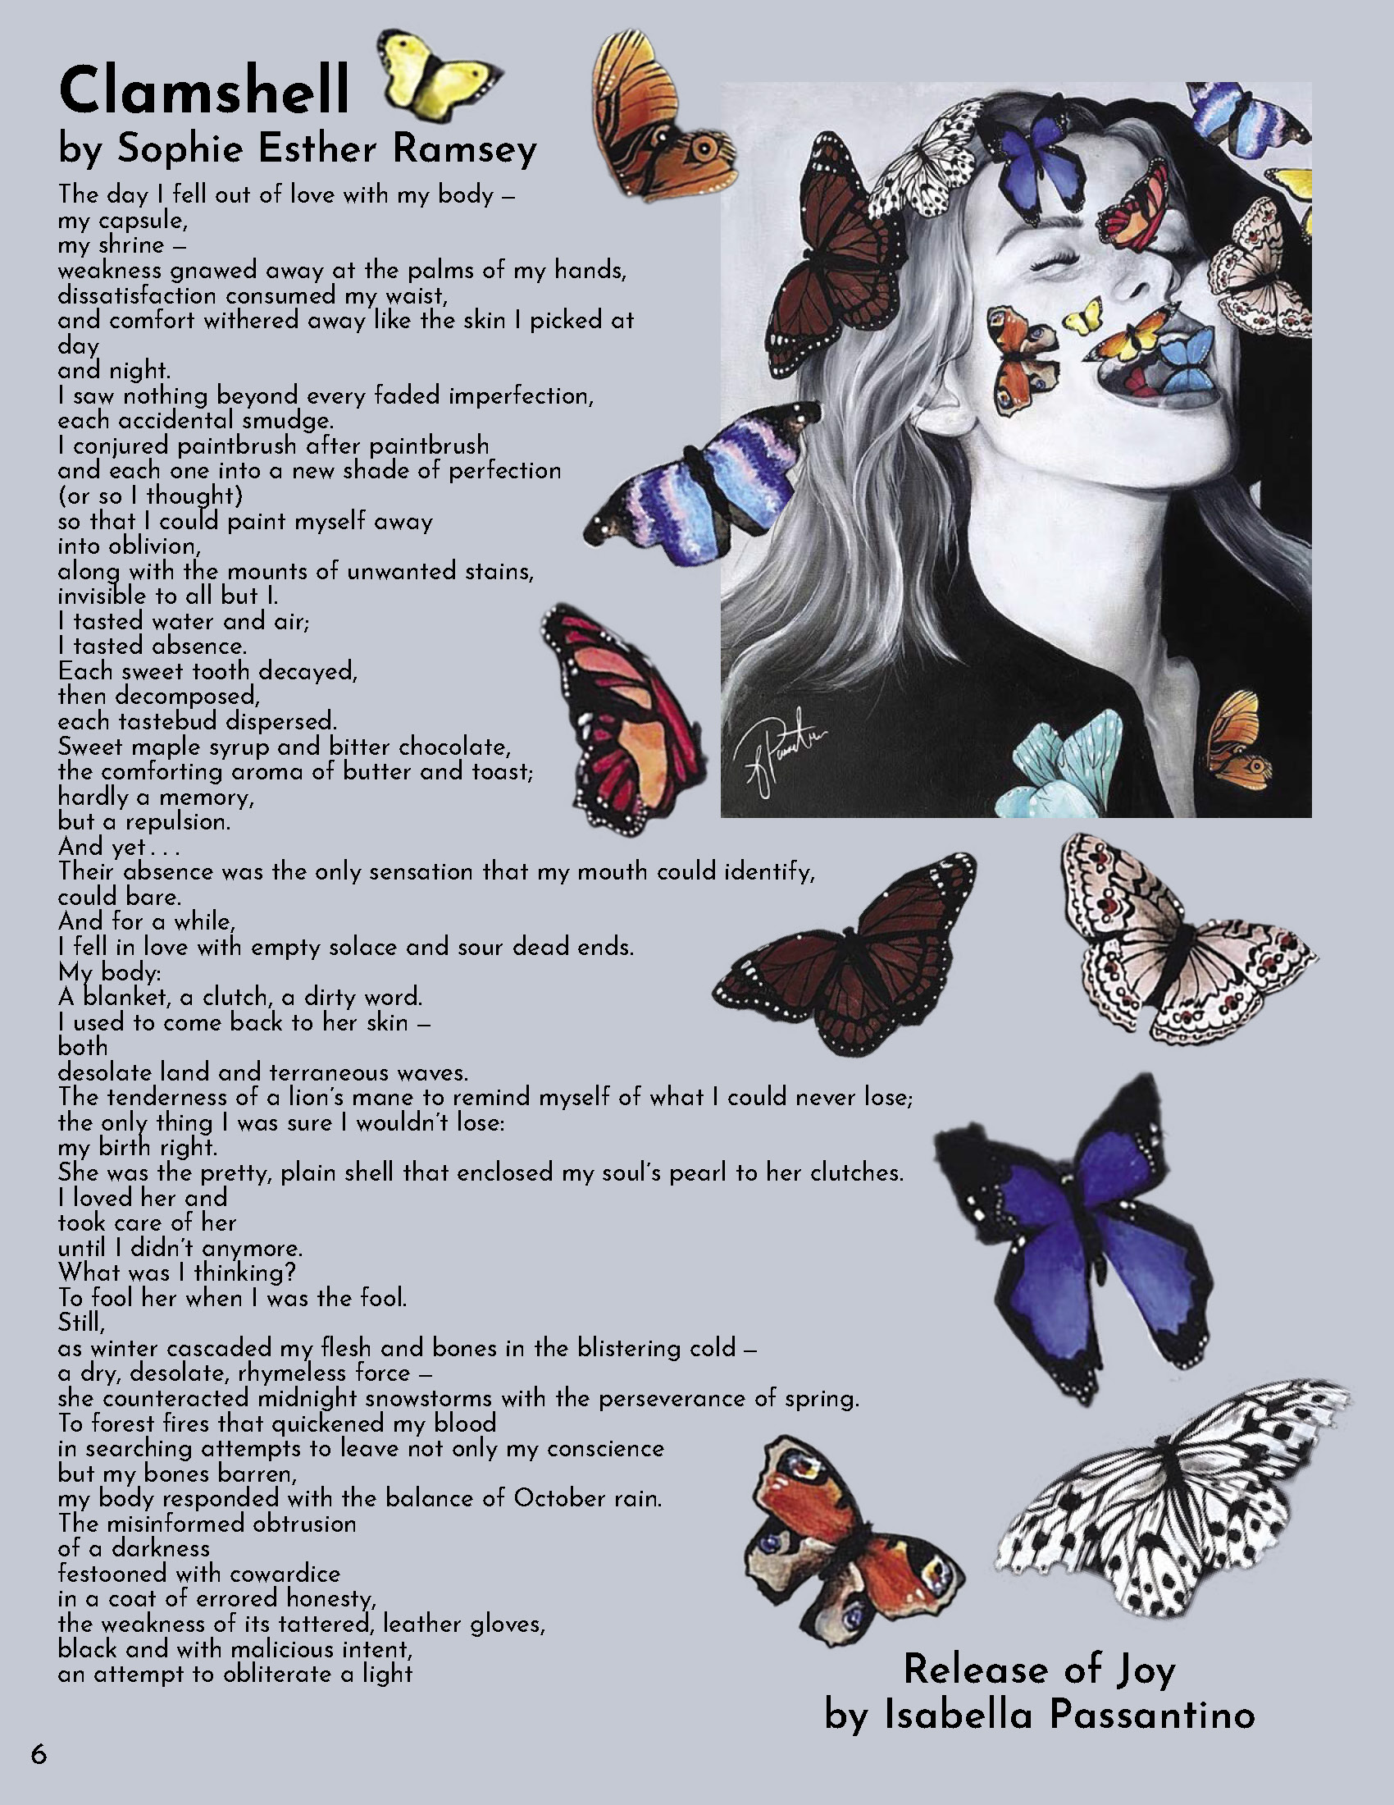
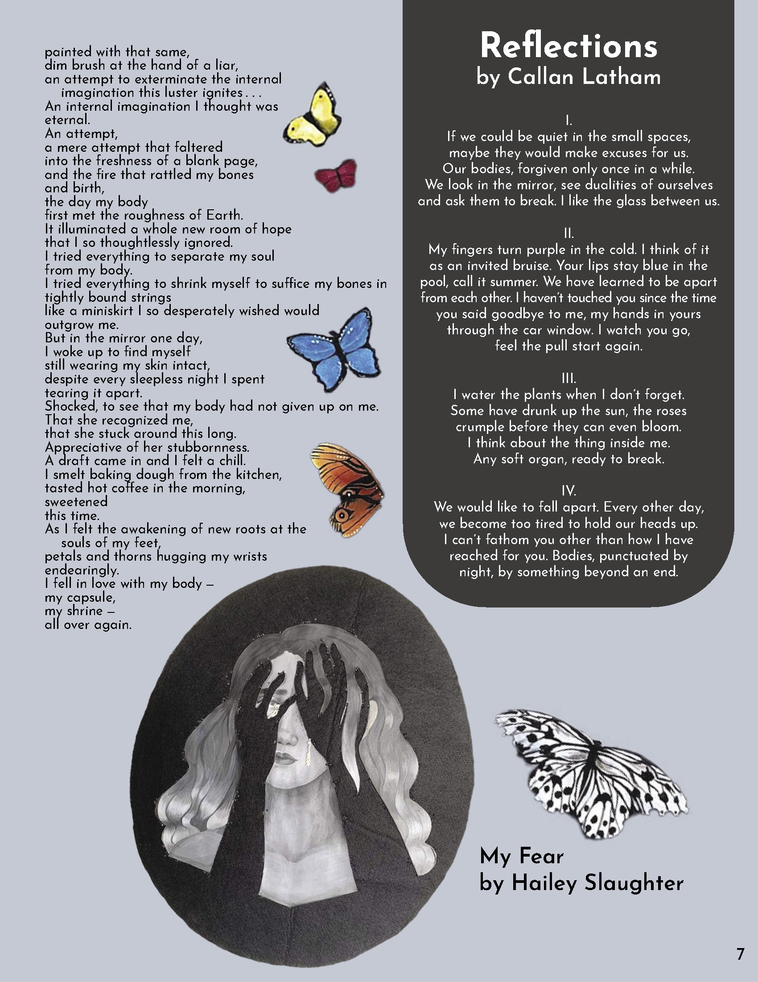

Slide 4
How to Get Published
Feb 1, 2022
Submissions of writing and art are due at
www.jocolibrary.org/elementia
Spring Break
Selections are announced and design work begins.
May 13, 2022
New issue released and we have a big party!
Notes:
Things to point out:
You can submit anonymously and it is a blind selection process, which means none of the readers know who you are (unless you leave your name at the top of your document)
You can submit as many pieces as you want.
You retain copyright to any works submitted to elementia, we just ask for the rights to publish them.
You can submit long pieces, although given at we only have about 70 pages to work with we may only print an excerpt in the magazine and publish the whole piece online.

Slide 5
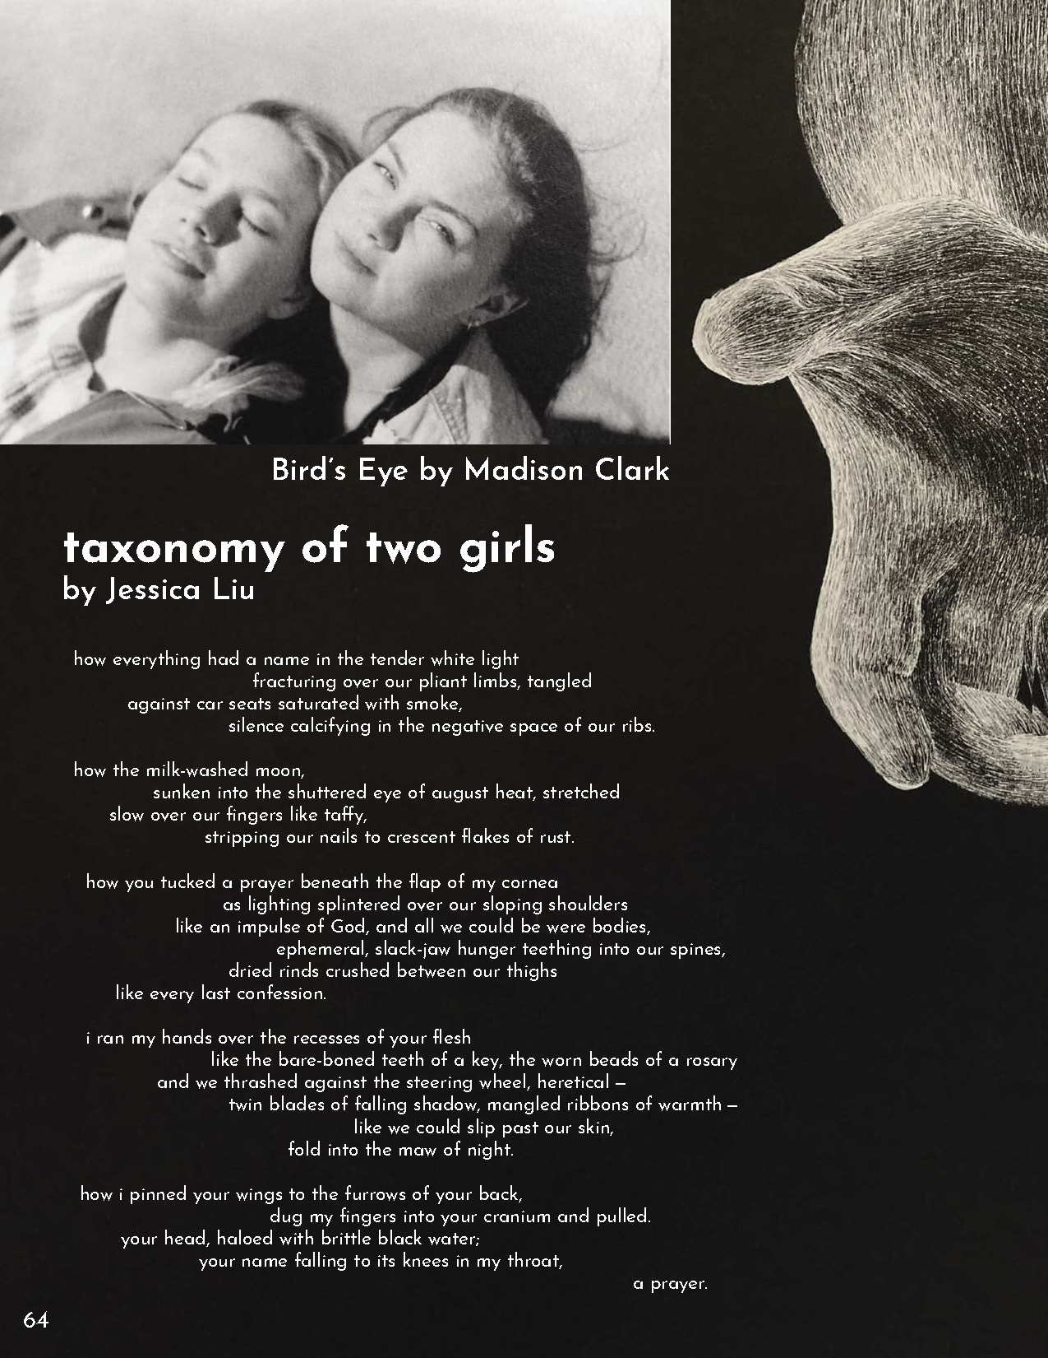
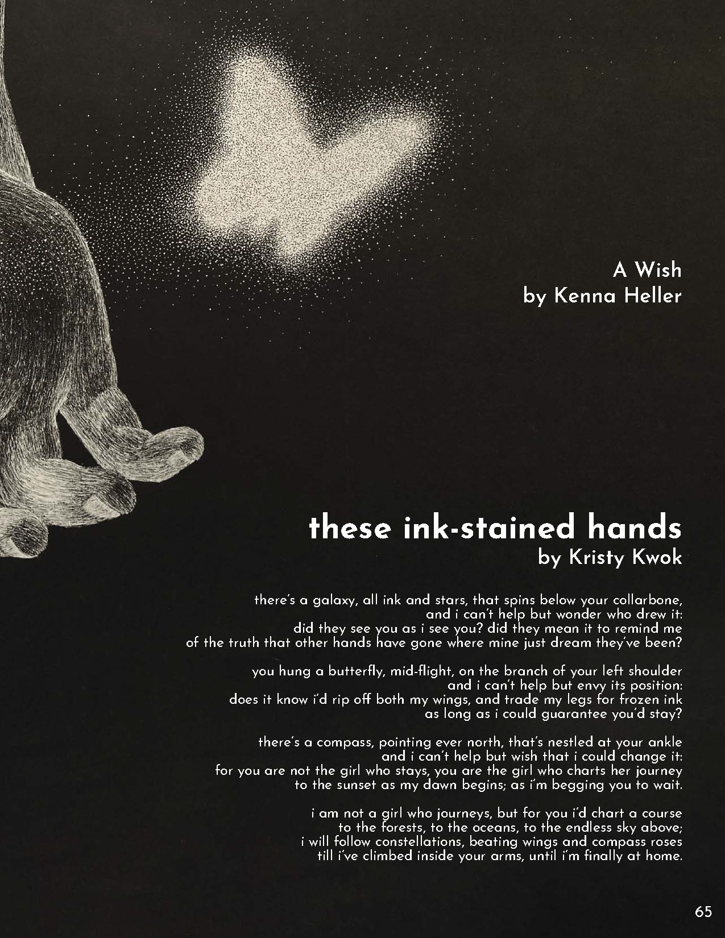

Slide 6
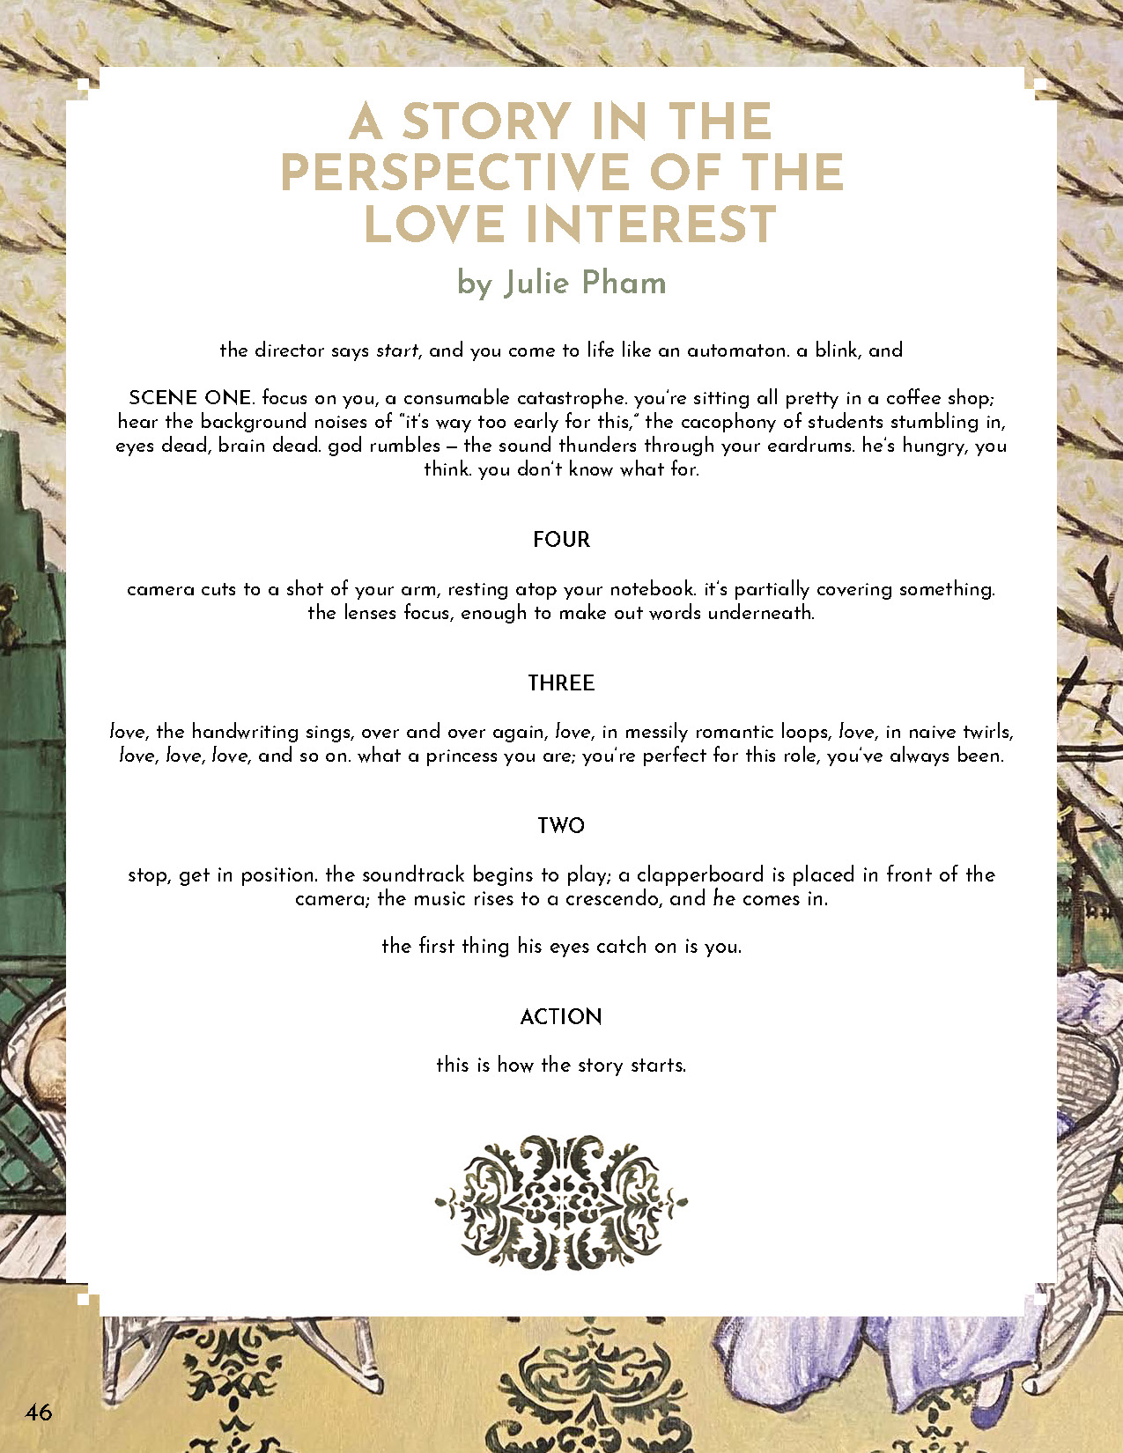
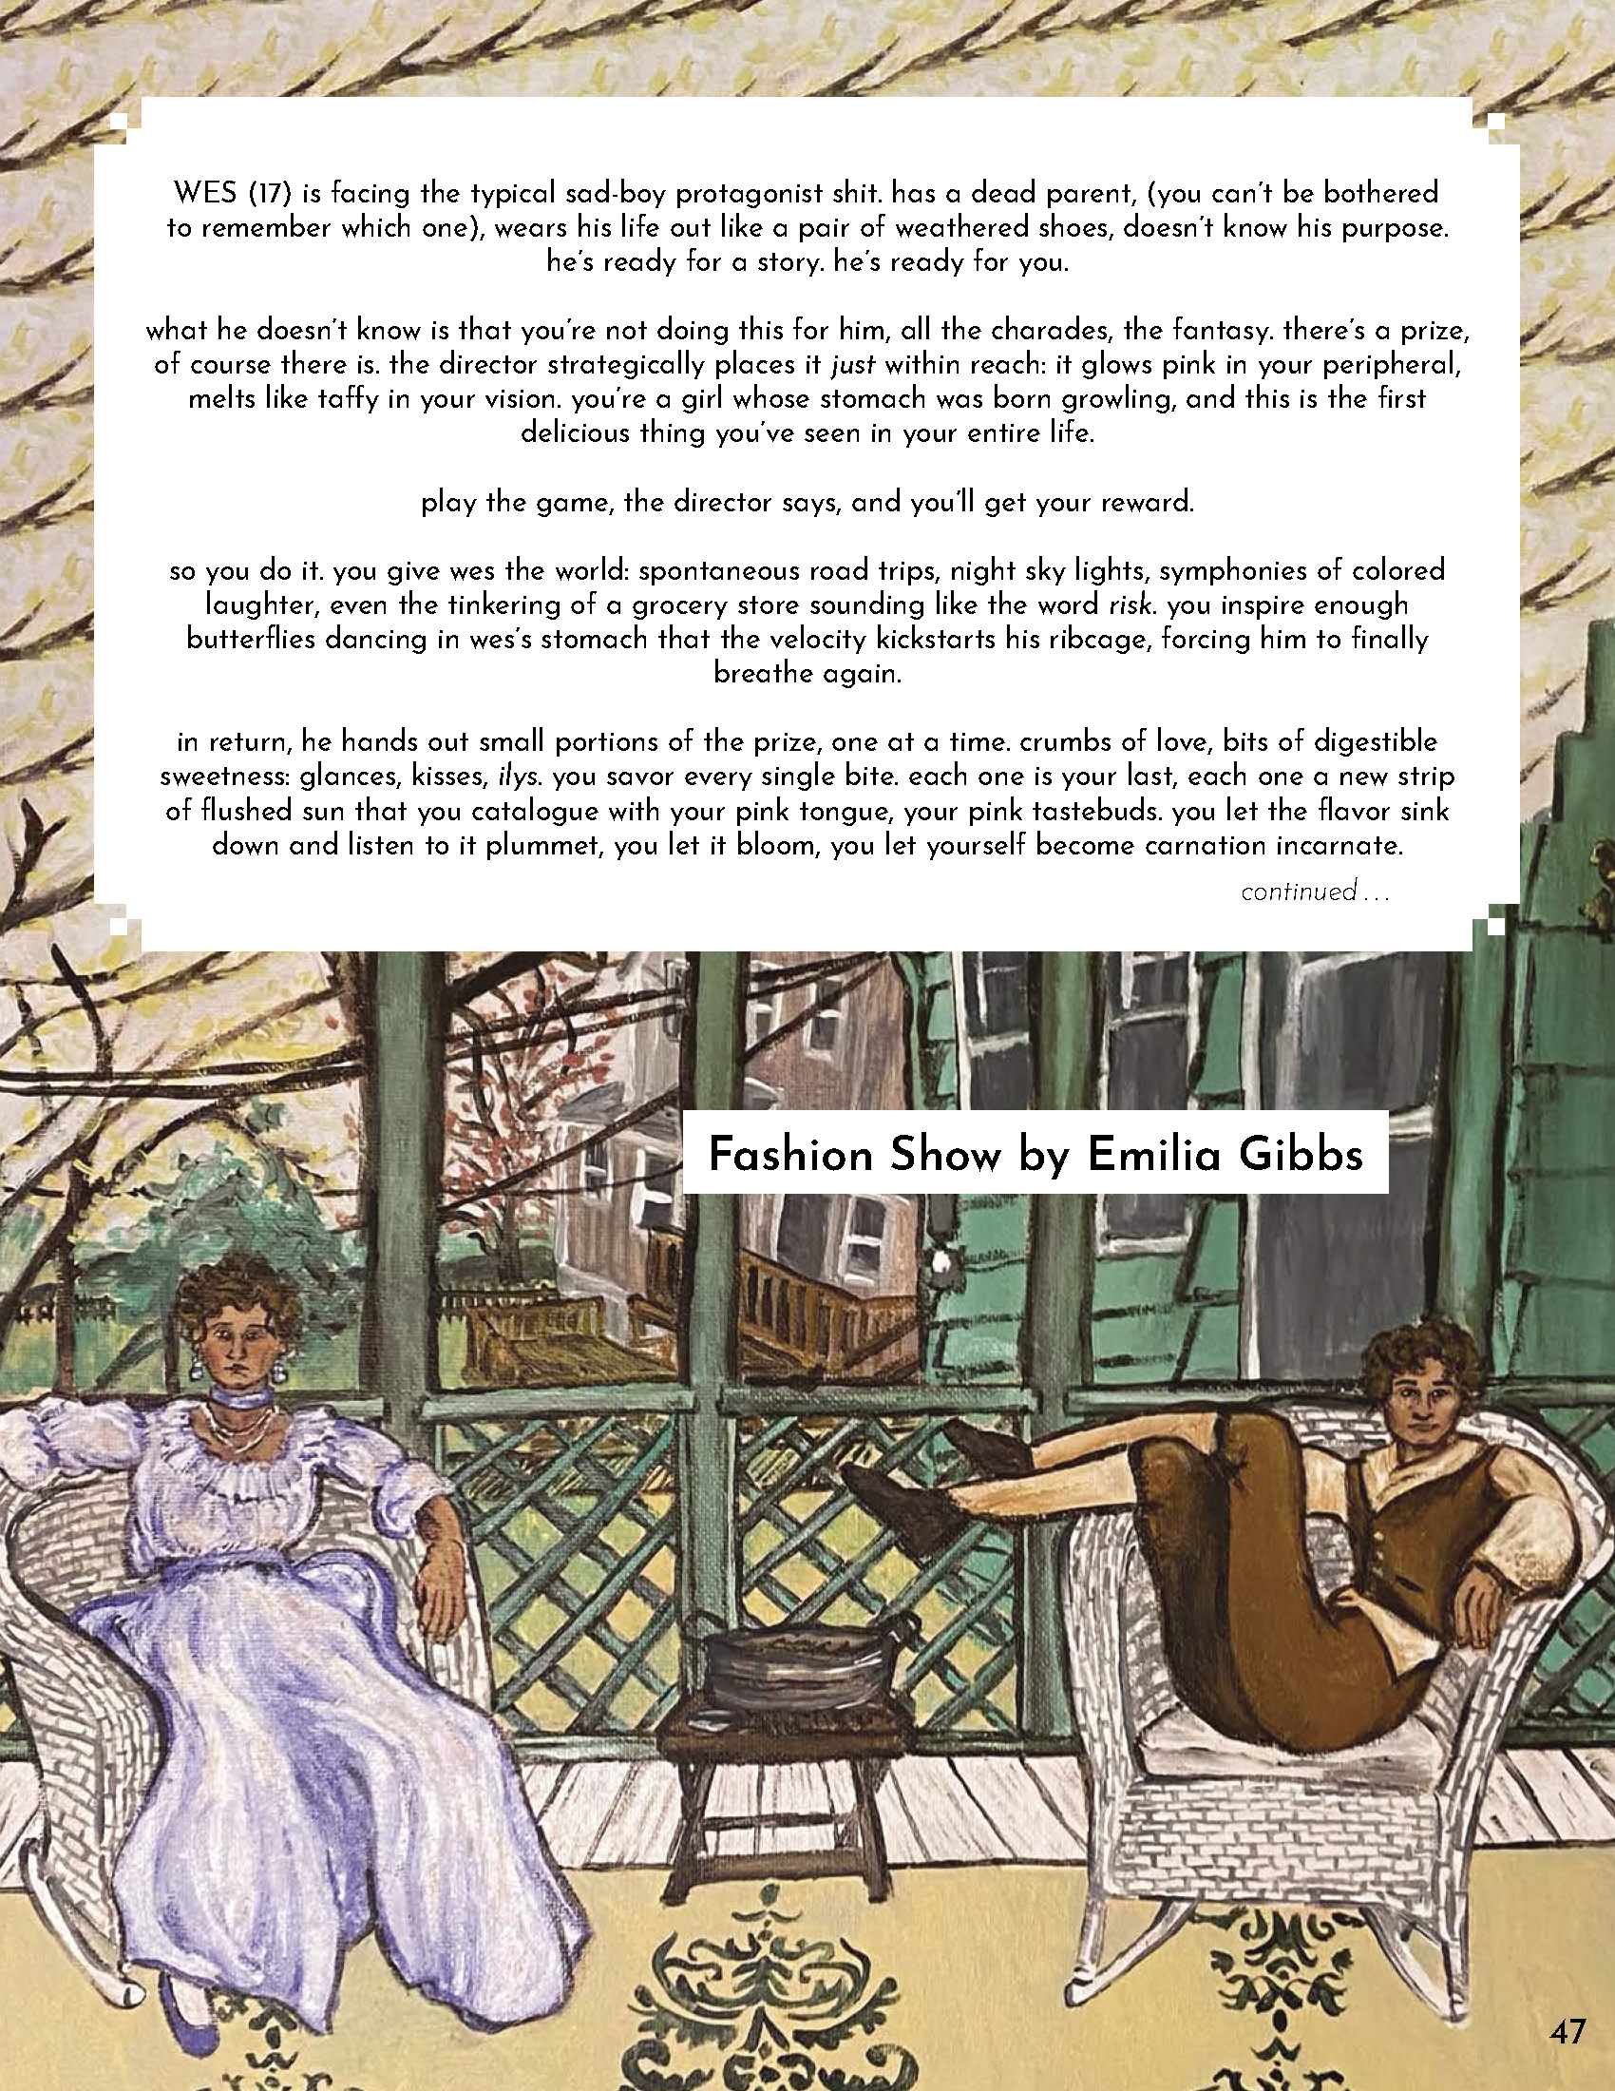

Slide 7
Recent keynotes
Rudy Fransisco
Franny Choi
Notes:
Mission Statement
The purpose of elementia is to publish, uplift and represent creative, eclectic teens, while also striving to:
foster and recognize the talent of teens.
maintain an open platform/forum for teens to share and connect.
publish a diverse range of original writing and art.
collaborate with community partners and schools to embed elementia into the classroom.
emphasize the importance of reading and the written word by connecting published artists with talented teens.
Facts
How many teens have been published in elementia?
elementia had published the writing and art of 730 creative teens since 2005 in 15 issues of the magazine.
Where have our authors been from?
elementia has published teens from all over the Kansas City Metro area, several states, England, Zambia and Malaysia.
Who produces elementia?
elementia is managed by Library staff, but the selection and design work is all done by a committed group of creative teens. They select the pieces that will go into the magazine, they design the magazine, and they choose the next theme and featured author.

Slide 8
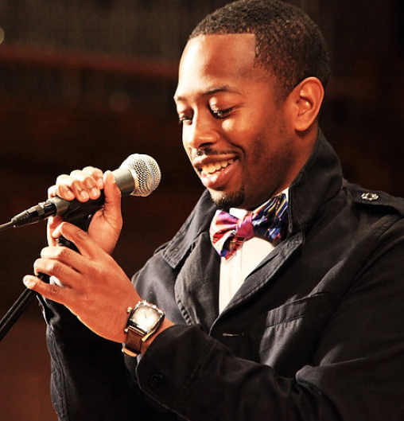
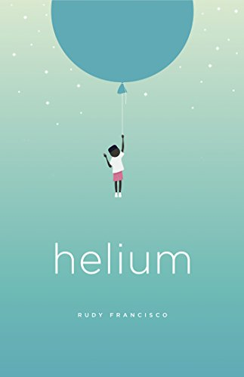
Rudy Francisco
Slidehood.com
Spoken word poet
National Underground Poetry Slam Champion
Author
CONNECTION

Slide 9
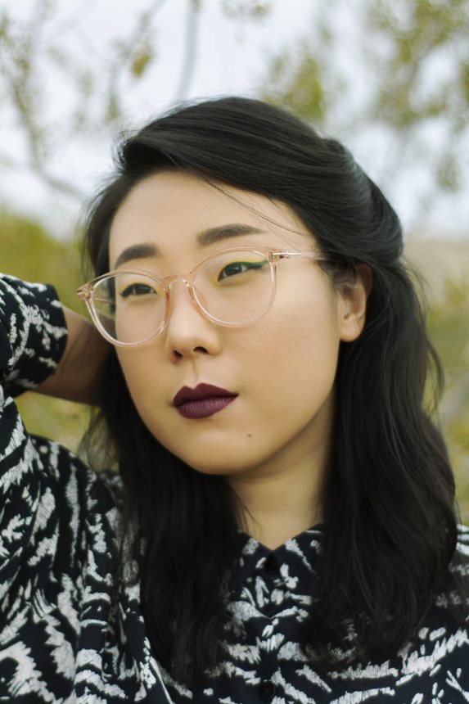
Franny Choi
Spoken word poet
National Slam Finalist
Podcast Host
Author
BODIES

Slide 10
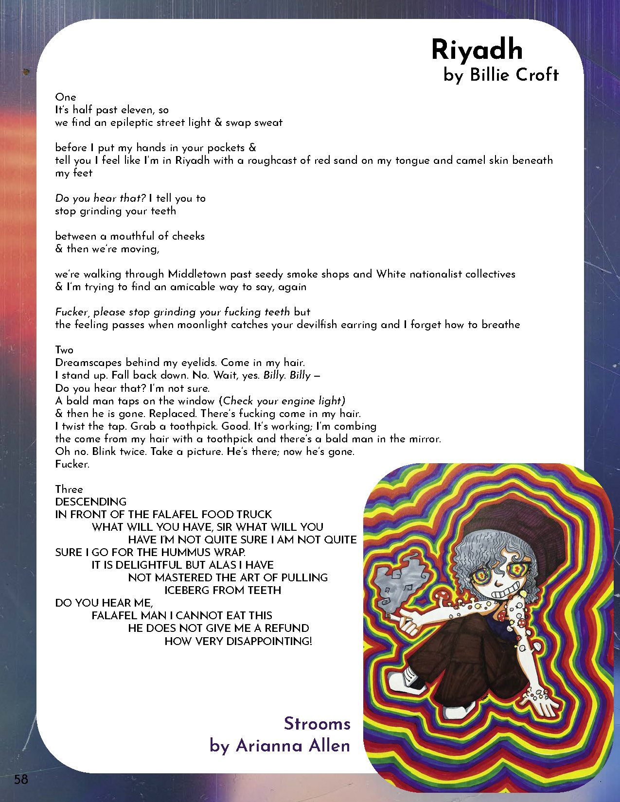
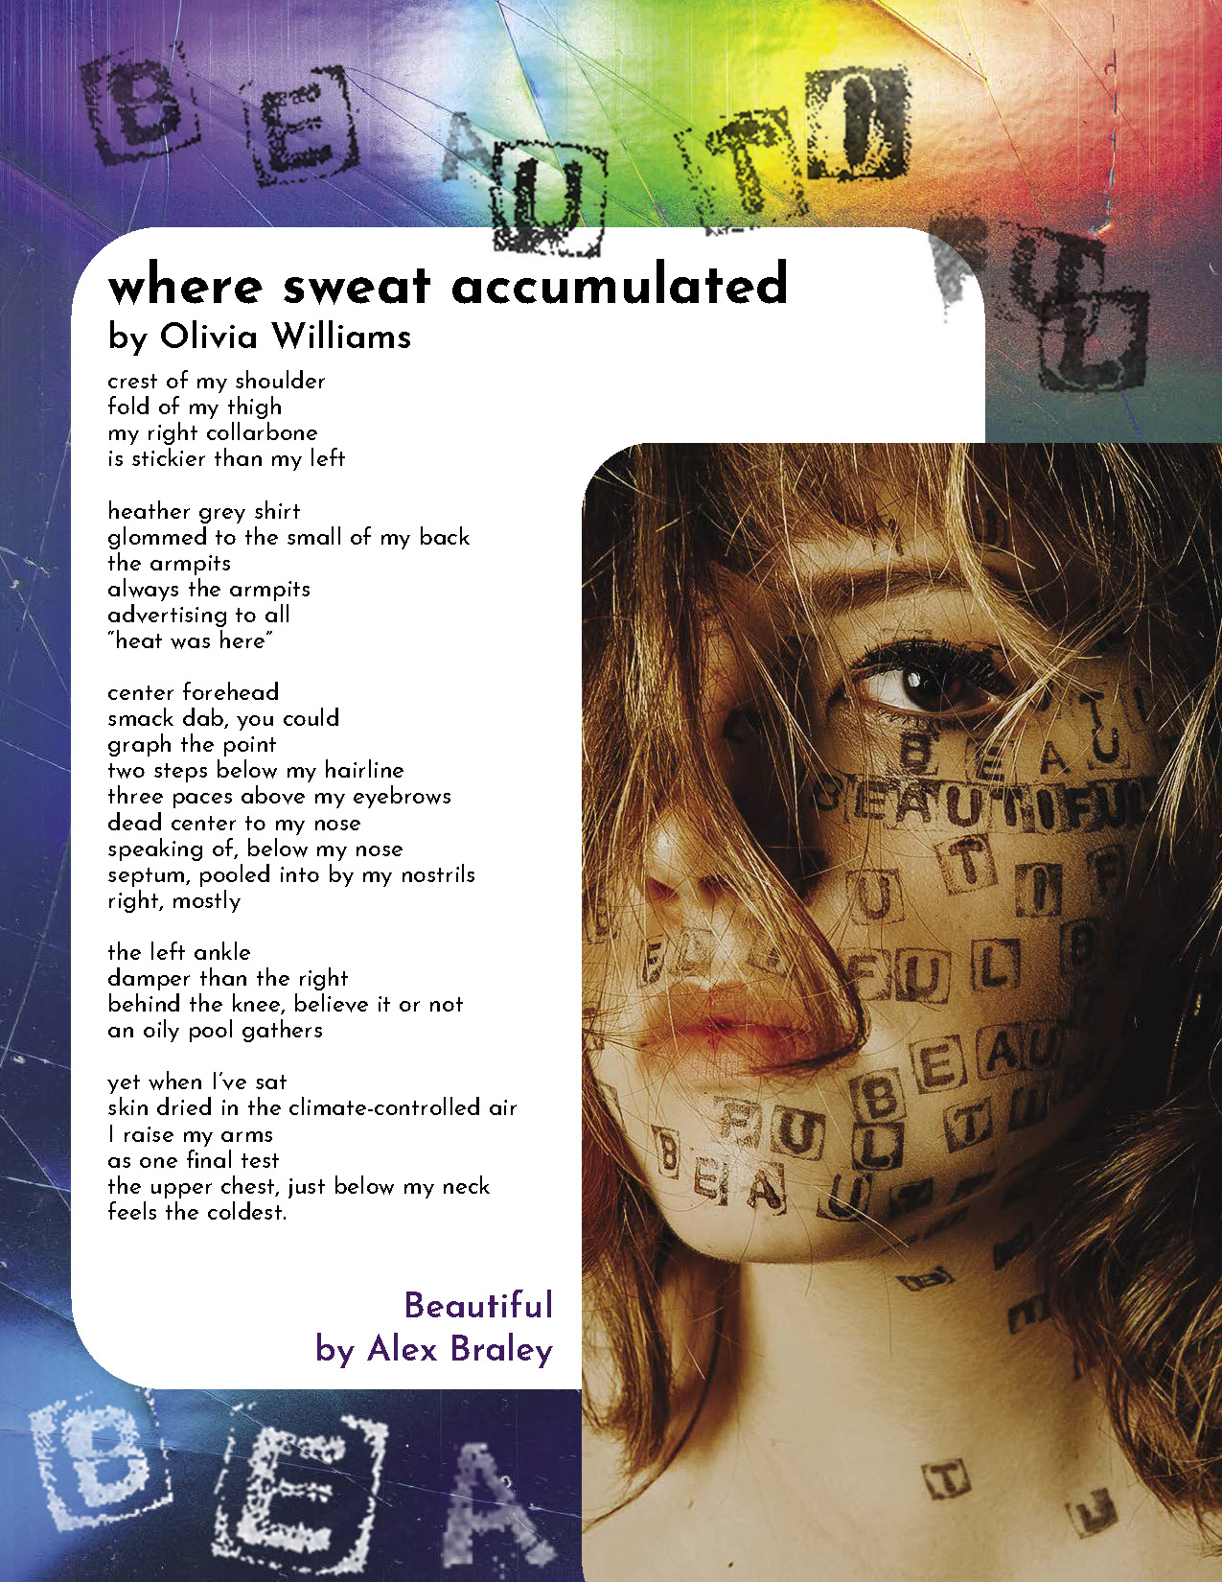

Slide 11
The Unknown
We’re always told to “create what we know,” but what about what we don’t know? From higher beings to the center of the Earth — there are so many things we’ve yet to discover. How can we sense the unknown? Feel it. See it. Overcome it. Does it terrify? Exhilarate? Comfort? How does confronting the unknown change our human experience? Communicate your dreams and anxieties. What do we not understand about ourselves? Our thoughts. Our motives. Our actions. How about outside our perception? Deign to view the imperceptible; speculate on the fabric of reality. In what ways do you try to dissect the unfamiliar, consciously or not?
Everything we know is learned: what have we not been taught? What has time robbed us of knowing? In what ways can we help each other reveal what’s hidden? Venture into the oceans, the night sky, the rainforests. Search for the aliens among us and beyond us. Find the murky edges of your imagination and focus on them. Visualize what exists in the afterlife and what is hidden in the dark. Take this opportunity to immerse yourself in the unknown.
Slidehood.com
We Accept Poetry, Graphic Stories, Fiction, Photography, Essays, & Illustrations

Slide 12
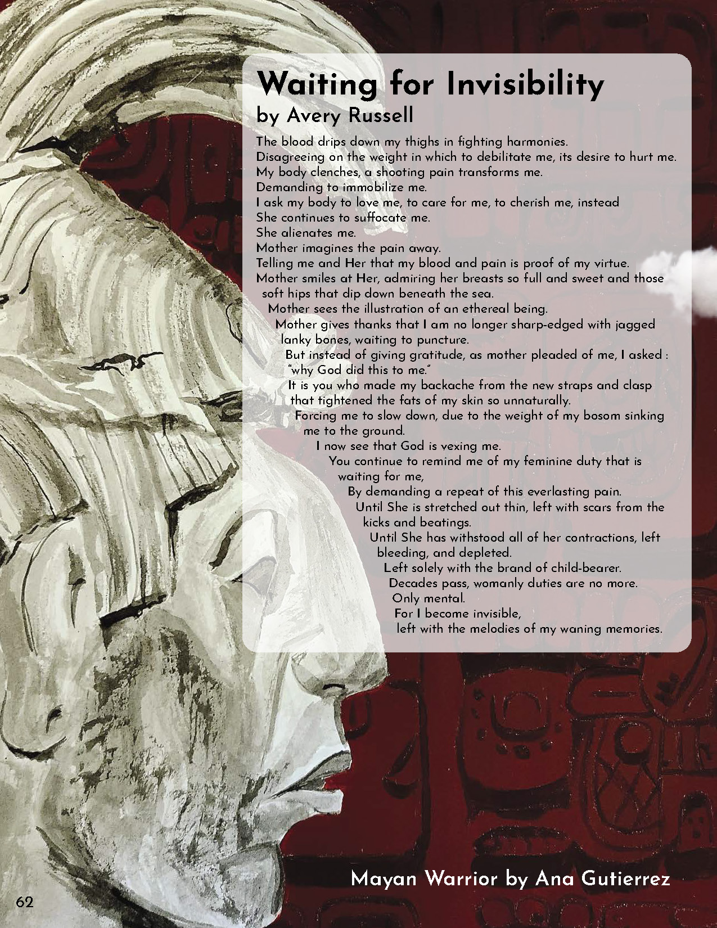
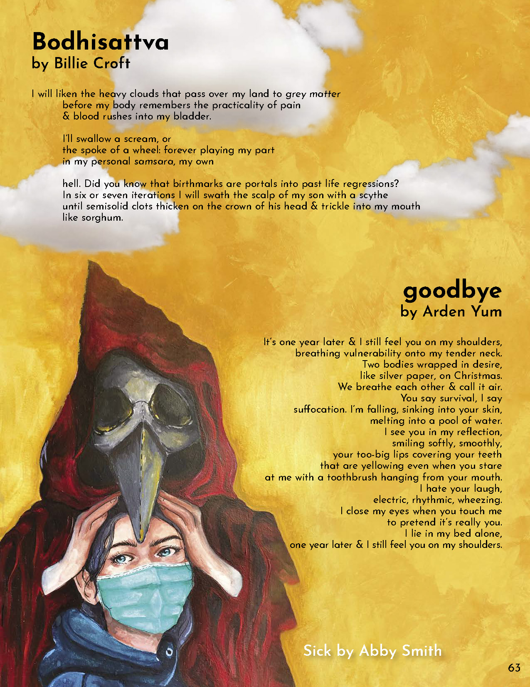

Slide 13
Prompts
What are you willing to leave unknown?
Has your perspective changed when you learn something you don't know?
Explore a dreamstates
What was one time in your life when you confronted the unknown?
Get a piece of paper and a pen or pencil ready!

Slide 14
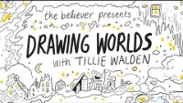

Slide 15
Other Opportunities for Writers & Artists
Shooting Stars Scholarship
Lit Up Festival Contest (May 2022)
Johnson County Library Writing Contests ($200 prize)

Slide 16
Questions
Slidehood.com
You can find us at:
www.jocolibrary.org/teens/elementia
Facebook: joco.elementia
Instagram: joco.elementia

Slide 17
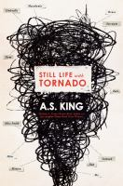
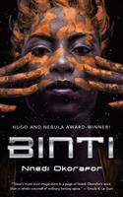
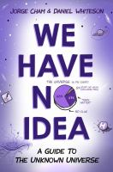



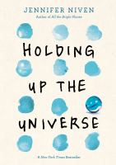
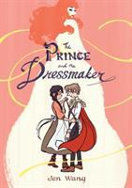


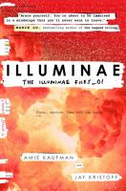


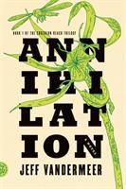



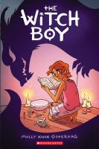

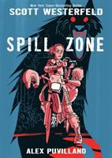
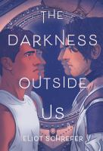

Keep reading about the Unknown

